Slide 1





An Archetype of a Stripped Wolf-Rayet Binary
Breelyn Cocke, Dr. Philip Massey
Northern Arizona University, Lowell Observatory

Slide 2
What is a Wolf-Rayet Star?
Evolved, massive star
Unusual spectra
Prominent broad emission lines of ionized helium, nitrogen, and carbon
Strong stellar winds
Has lost its outer hydrogen and is fusing helium (or heavier elements) in its core
Hotter than most other kinds of stars (highly luminous)

Slide 3

Binary Star System
Two stars that are gravitationally bound to & orbit around their center of mass
Our binary system of observation: LMC 173-1
In the Large Magellanic Cloud
O7.5V + WR
Studied over course of 19 observations from 2013-2024
Magellan & Gemini Telescopes

Slide 4
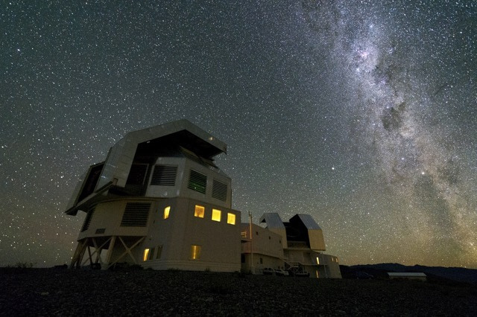

Magellan (13 nights of observing)
Gemini (6 nights of observing)

Slide 5
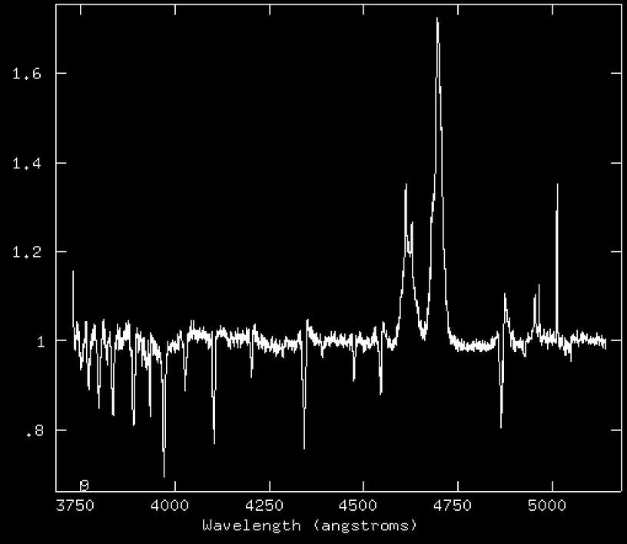
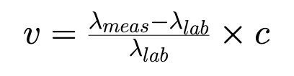
Velocity Calculation
Spectra
H-Delta
Example from January 23rd, 2021

Slide 6
What can we learn from this?
Period of the system using a Lafler-Kinman search
Orbit solution using differential least-squares and assuming circular orbits
Mass ratio between the stars

Slide 7
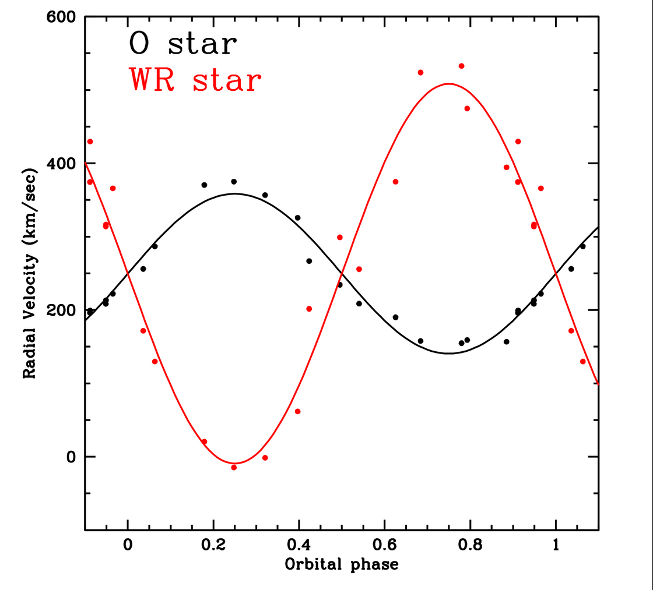
Orbit

Slide 8
Conclusion
We can approximate the orbital inclination (i), by assuming the WR is ~1 million years old and the O7.5V star to be ~20 solar masses
Mass of the WR star is 8.4 solar masses if the O star is 20 solar masses
Thus, the WR star is only about 42% of the mass of the O star
The WR has lost 58% of its mass
Is it possible this mass loss was purely due to solar winds, or does it suggest stellar evolution via binary stripping?

Slide 9

Thank you! Questions?

